Slide 1
Customer Data Analysis
PROJECT CODE: PRDA – 04
Team code: PTID-CDA-SEP-26-11164
Tools used: excel for analysis and power bi for visualization.

Slide 2
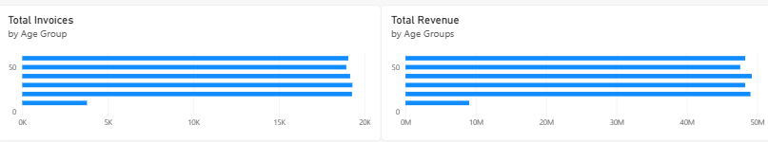
Gender Insights
Female customers: 620 invoices, ≈ 1.41M TL revenue
Male customers: 380 invoices, ≈ 0.96M TL revenue
Women drive both higher volume and revenue

Slide 3
Age Insights
18–27 years: highest invoice count (205)
58–67 years: highest revenue (≈ 560K TL)
Younger shop more often, older spend more per purchase

Slide 4
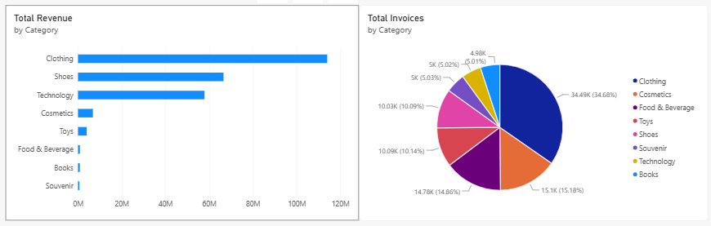
Category Distribution
Clothing dominates (338 invoices, ≈ 1.05M TL revenue)
Shoes second in revenue (≈ 685K TL)
Technology smaller in count but high revenue (≈ 493K TL)

Slide 5
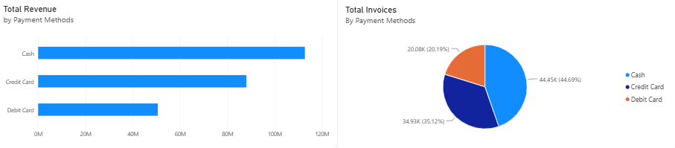
Payment method Insights
Cash most common (420 invoices, ≈ 1.04M TL)
Credit & Debit cards together ≈ 1.32M TL.
Digital payments are rising — opportunity for loyalty programs.

Slide 6
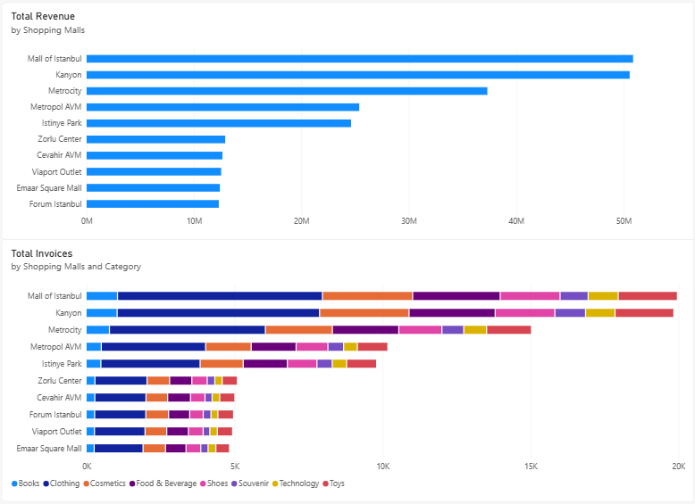
Mall Distributions
Mall of Istanbul (206 invoices) & Kanyon (195 invoices) are top performers.
Clothing dominates across malls.
Food & Beverage strong in Kanyon, Toys strong in Metrocity.

Slide 7
Recommendations and suggestions
Target promotions toward female shoppers.
Offer premium bundles for older age groups (58–67).
Expand Clothing & Shoes inventory.
Incentivize card payments (cashback, loyalty points).
Focus marketing campaigns in Mall of Istanbul & Kanyon.

Slide 8
Conclusion
Customer behavior varies by gender, age, and mall location.
Strategic focus on top categories and malls can maximize revenue.

